Slide 1
PHM ExploreR User Guide
Andras Varady
Modelling and Analytics, BNSSG CCG

Slide 2
About These Guides
This set of documents aims to serve as a user guide for the PHM ExploreR.
It is worth noting that this is not an exhaustive set of uses, and mostly server to help get you started, or provide examples as to how it’s been used
This document assume you have already set up the ExploreR. See Data Formatting.pptx (should be in the same folder) on an explanation of how to create the tables used

Slide 3
General Pathway
If you’re looking to explore a particular cohort:
Create an Analysis Dataset (please refer to PowerPoint ExploreR Analysis Dataset Construction for steps on this)
Click ‘Go!’ on the landing page to load the ExploreR
Explore the Analysis Dataset using the tools available in the PHM ExploreR

Slide 4
General Pathway
If you’re looking to compare two cohorts, either:
Create two Analysis Datasets (one for each cohort), then run the same analysis on each
Or create an Analysis Dataset the contains both cohorts, then use the Cohort Identification page (naming of this may be a little confusing) to create a field the splits the Analysis Dataset into the two cohorts of interest. This new field will be available on every page to use to segment the population

Slide 5
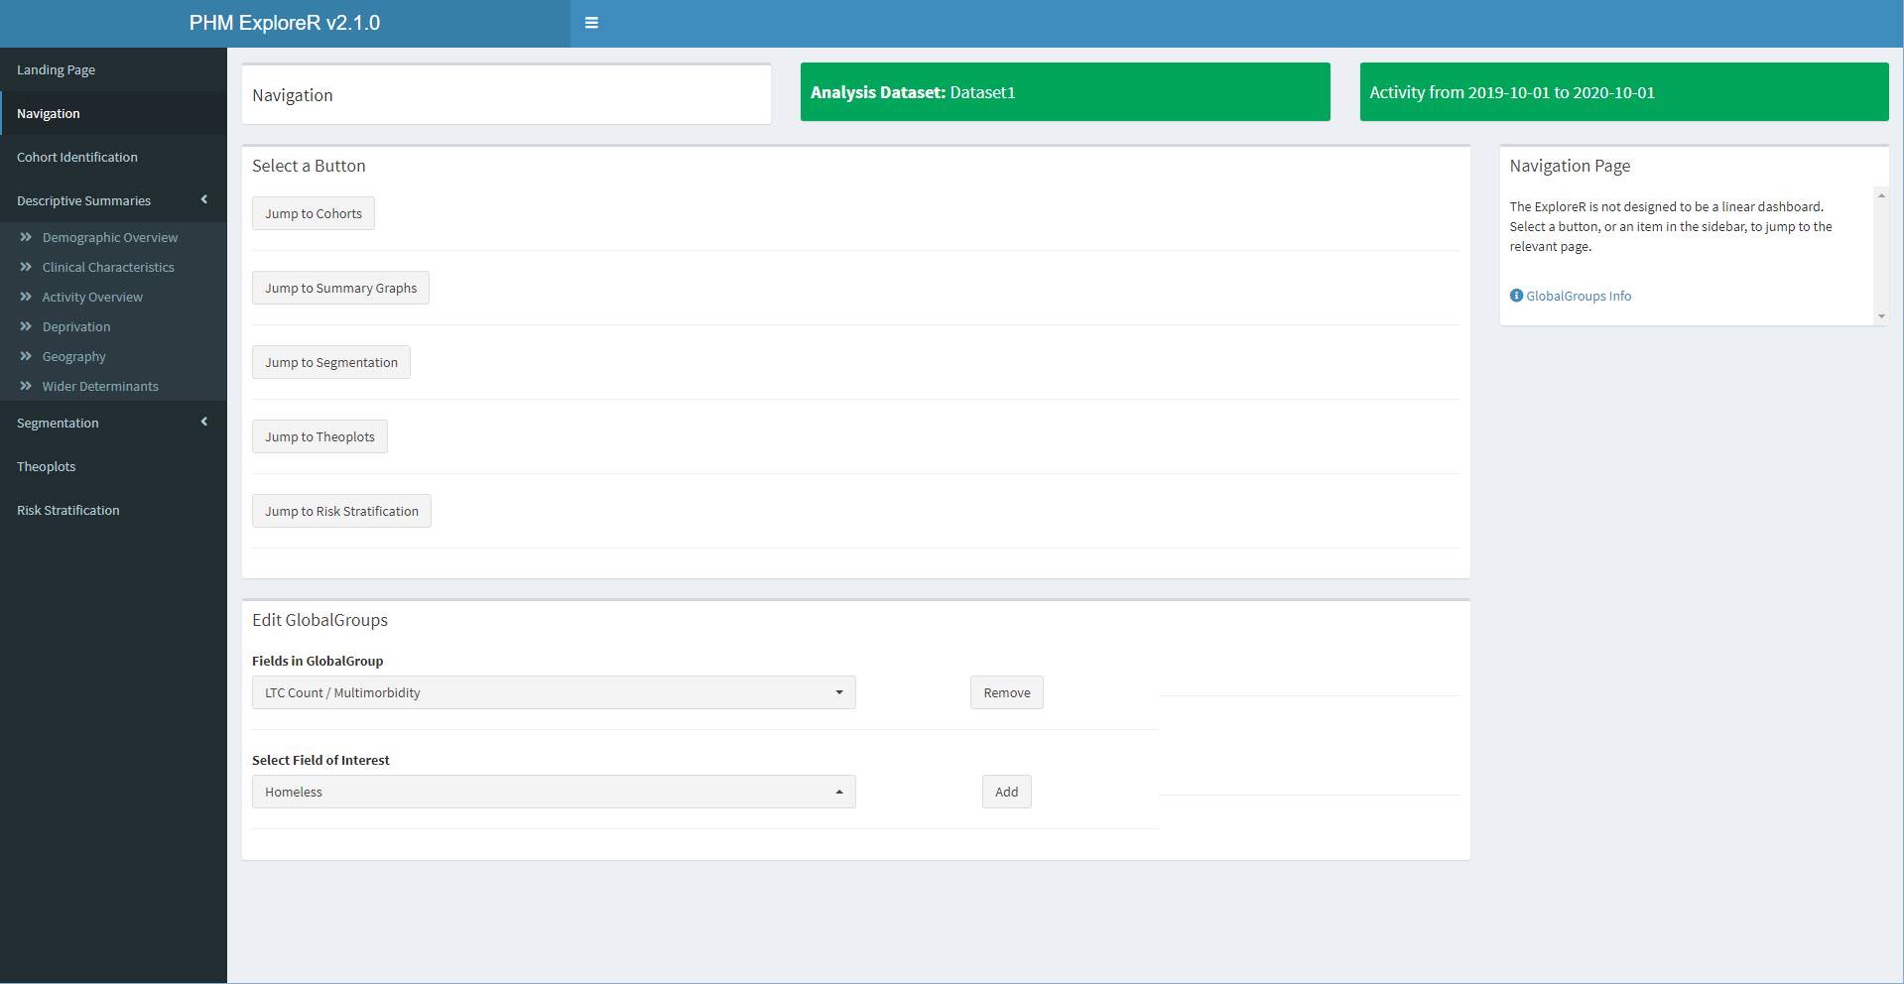
General Structure
Costs and activity are aggregated over this period
Selected dataset
Sidebar for navigation
Most pages have some extra info about contents

Slide 6
What functions are in the ExploreR?
The ExploreR is a generic tool. This means you may need to think about how you segment the population to obtain the data you’re interested in, and how you use the options available to you

Slide 7
Descriptive Summaries
These pages provide a series of graphs summarising ethnicity, multimorbidity, cost, activity, deprivation, etc.
Includes:
Population pyramid(s), with options to segment by a number of fields, including clinical conditions
Bar charts to view condition prevalence and multimorbidity in the population
Bubble plots of spending or activity
Bar charts to view the population by Deprivation, Geographical features, and wider determinants
For more flexibility, use the ‘Generalised Barcharts’ page

Slide 8
Segmentation
Provides methods to segment the population, usually by patient attributes
Includes data-driven techniques (decision trees, K-means clustering)

Slide 9
Theoplots
Samples and graphs patient-level activity based on selected criteria
Group theoplots useful for comparing multiple patient pathways of a particular activity type

Slide 10
Risk Stratification
Stratifies the population into 10 groups ranging from least at risk to most
Uses attributes and 12 months of historic activity to fit regression curve(s) and predict expected activity usage

Slide 11
Meta Options
The GlobalGroups variables are present on every page, and can be edited (i.e. if you have a particular field of interest, add it here)

Slide 12
Meta Options
Only fields with few (<=10) unique values can be added (restricted due to concern over plotting times).
General idea is to allow segmentation on any page by any attribute

Slide 13
FAQs
Q: What are the 1s or 0s when looking at a clinical condition?
A: All clinical conditions are encoded in a format where 0 means condition not present, 1 means condition present

